Slide 1
Project Demo 2
Team Lead Iain Fehr Juan Enriques Mendes Angel Escalera Aguirre

Slide 2
Problem Statement
Modern mobile users often experience short periods of idle time—waiting in lines, taking breaks, or commuting—but lack engaging, time-efficient entertainment options. Many mobile games require lengthy sessions, making them unsuitable for quick play, while passive activities like social media scrolling offer little interactivity.
Group F is bringing back the beloved card game Triple Triad, reimagined for the modern world. Introducing Triple Tactics: your pocket-sized portal to quick, engaging card battles. Picture this: you're on a short break, waiting in line, or just winding down before bed. Instead of scrolling aimlessly, you pull out your phone or tablet and dive into a fast-paced Triple Tactics match. Each game is designed to last no more than 45 seconds, making it the perfect bite-sized entertainment for those fleeting moments of free time.

Slide 3
Business Goals
Quick and Engaging Gameplay:
Games should be quick and fast enough to play within any free minute
Collectability
Players should be able to collect and unlock new cards after gameplay
Potential for Expansion
New cards should be able to be added quickly and easily
Accessible Anywhere
Players should be able to play on any platform of their choosing without issue

Slide 4
Development Tools
Iain Fehr has utilized Renpy a smaller free game engine built in python to build the basic structure for the local and Multiplayer environment.
Currently Programs like Photoshop has been utilized by Juan to create the current game assets, Angel has utilized Flask, a web platform based in Python, to create a back end webapp that will hold the multiplayer functionality and the API for the game engine to push changes to the server. He has also utilized SQLite for the servers Data Storage to keep track of gameplay.
A Git repository holds all project files and was created initially as an efficient way to share and divide tasks during development.

Slide 5
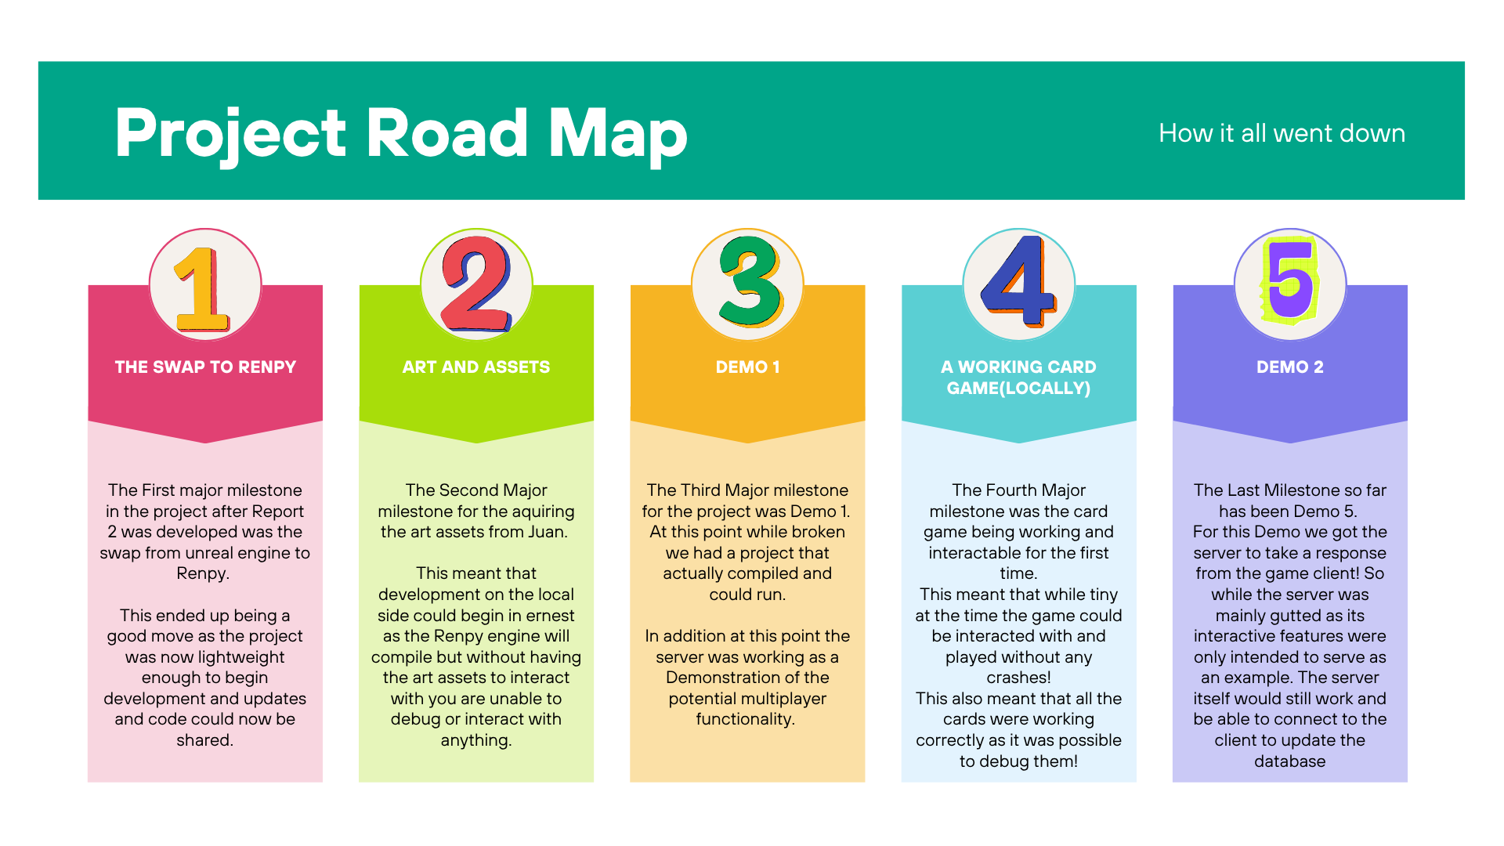

Slide 6
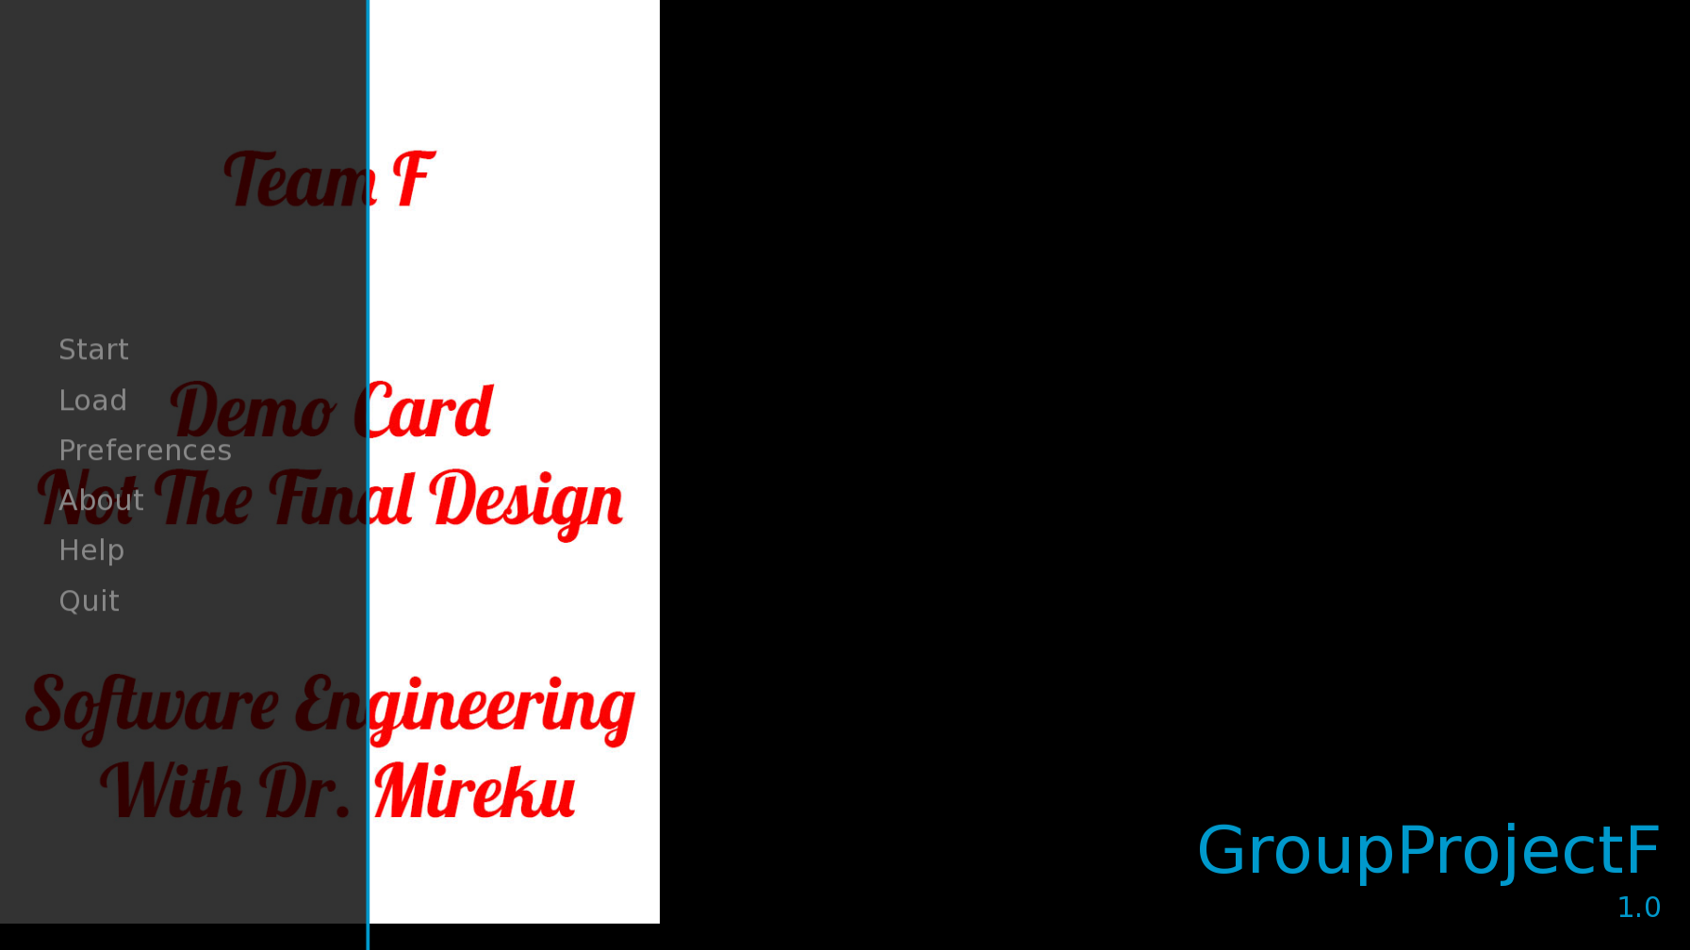

Slide 7
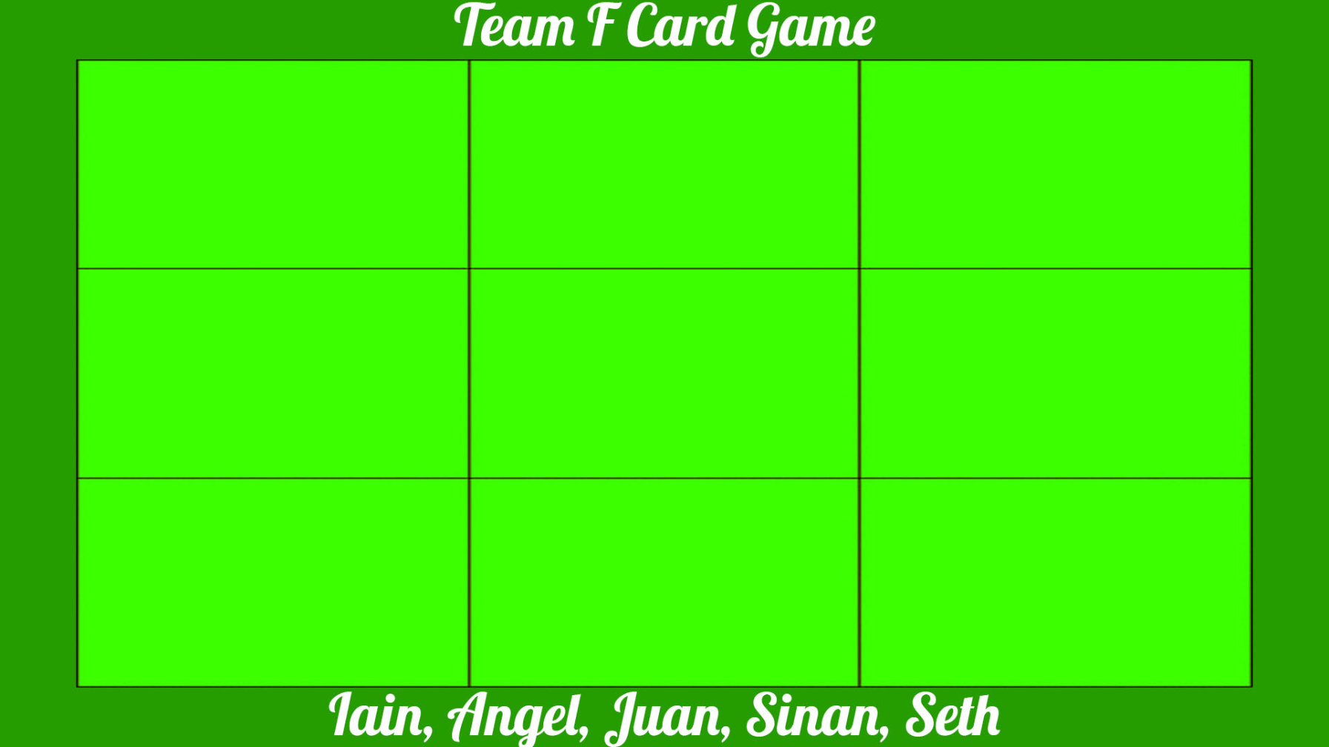
Previous Game board

Slide 8
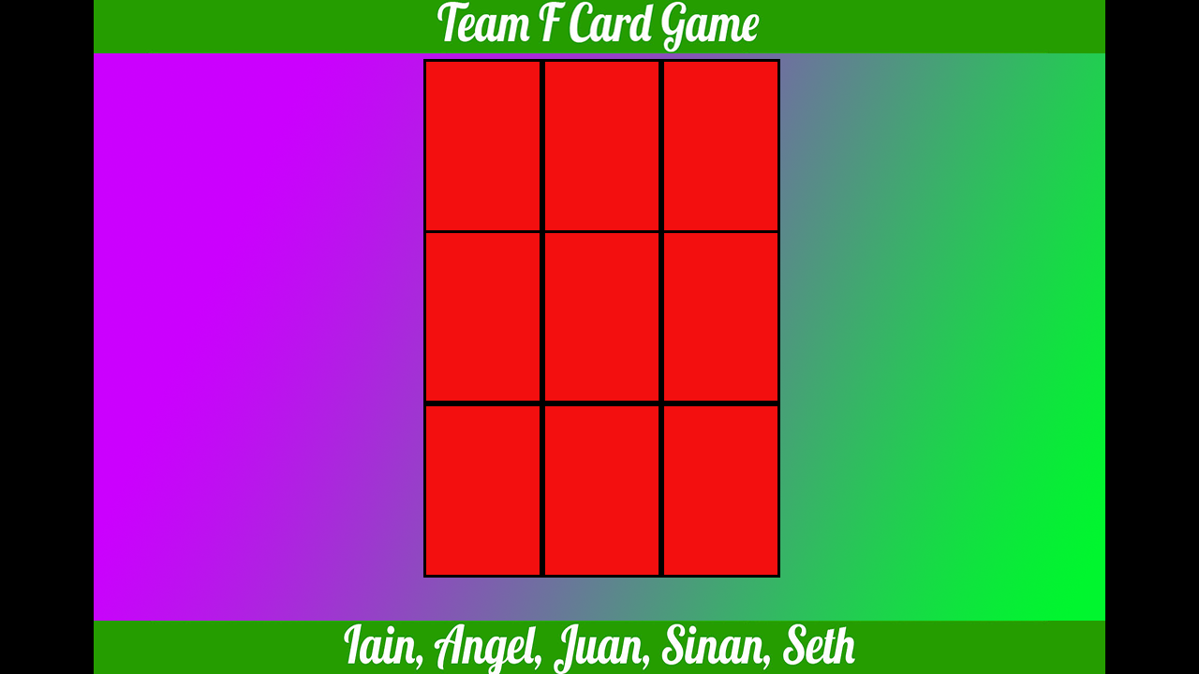
New game board

Slide 9
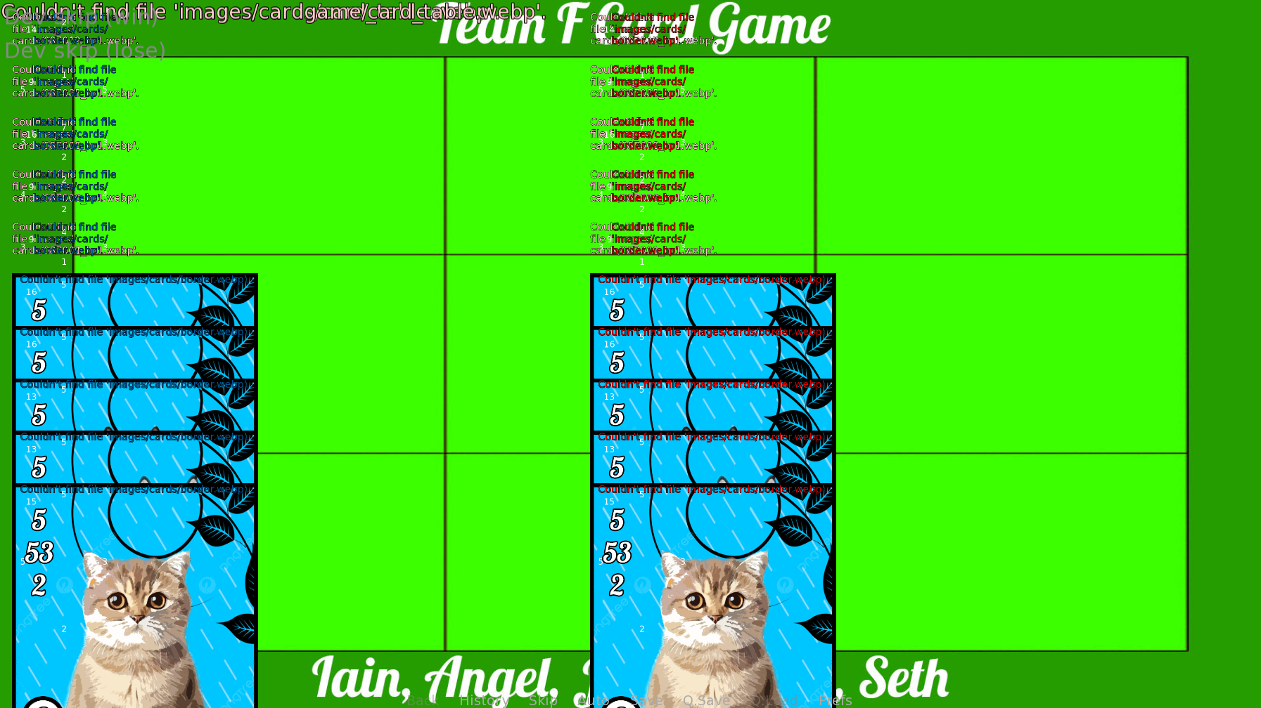
Bugged UI

Slide 10
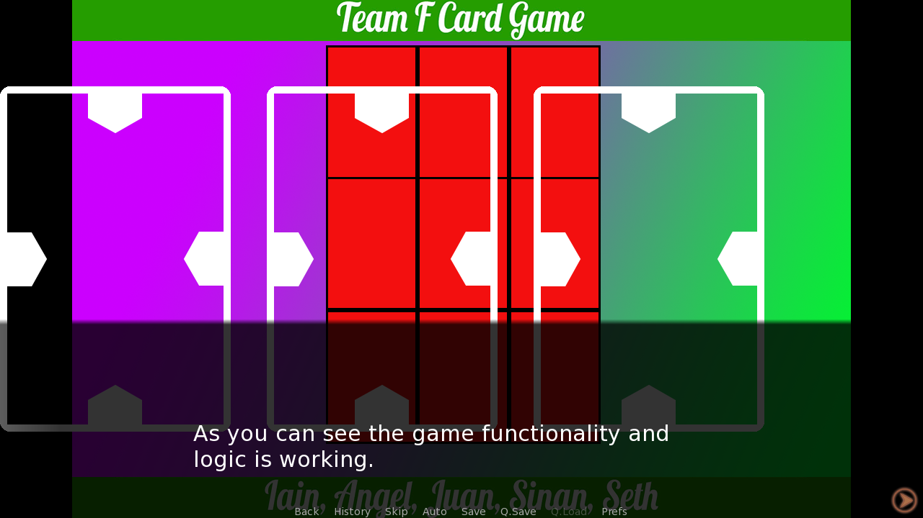
A Menu!

Slide 11
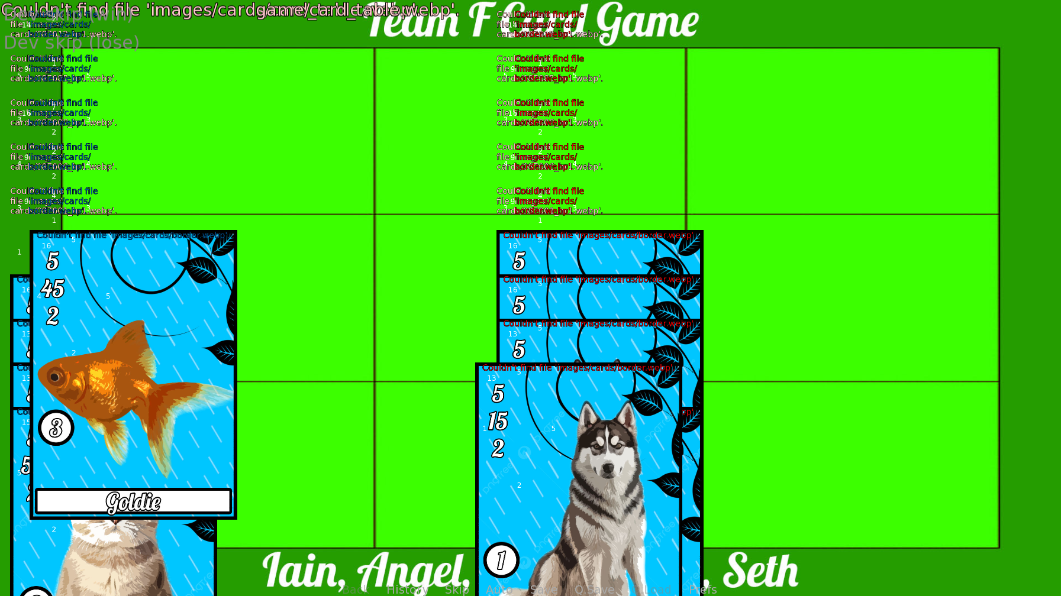
Card Selection Overlap

Slide 12
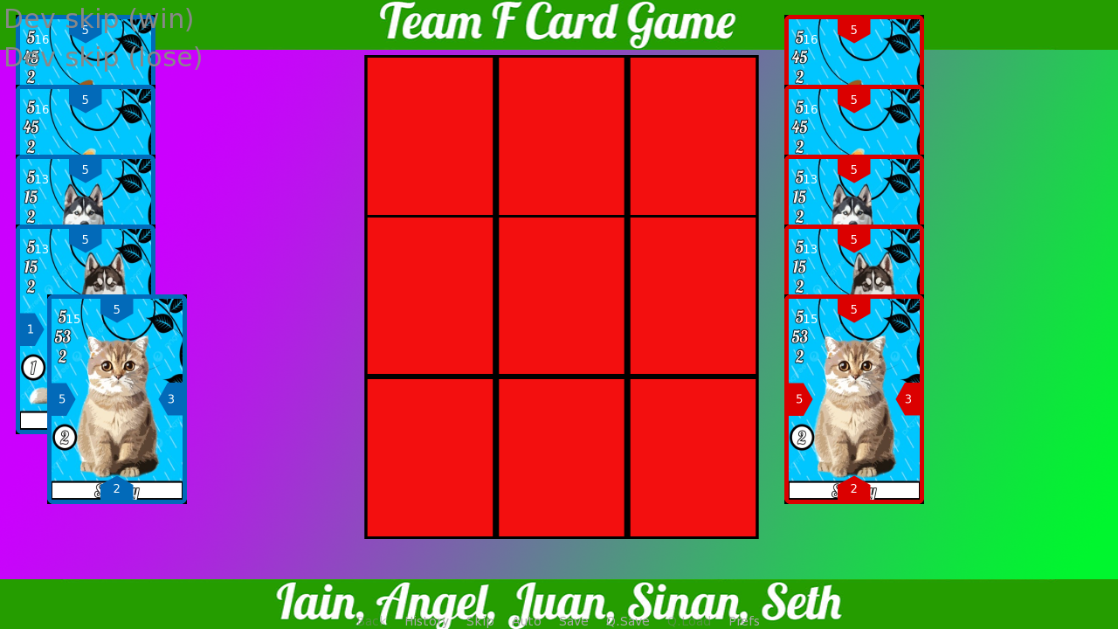
Clean Card Selection

Slide 13
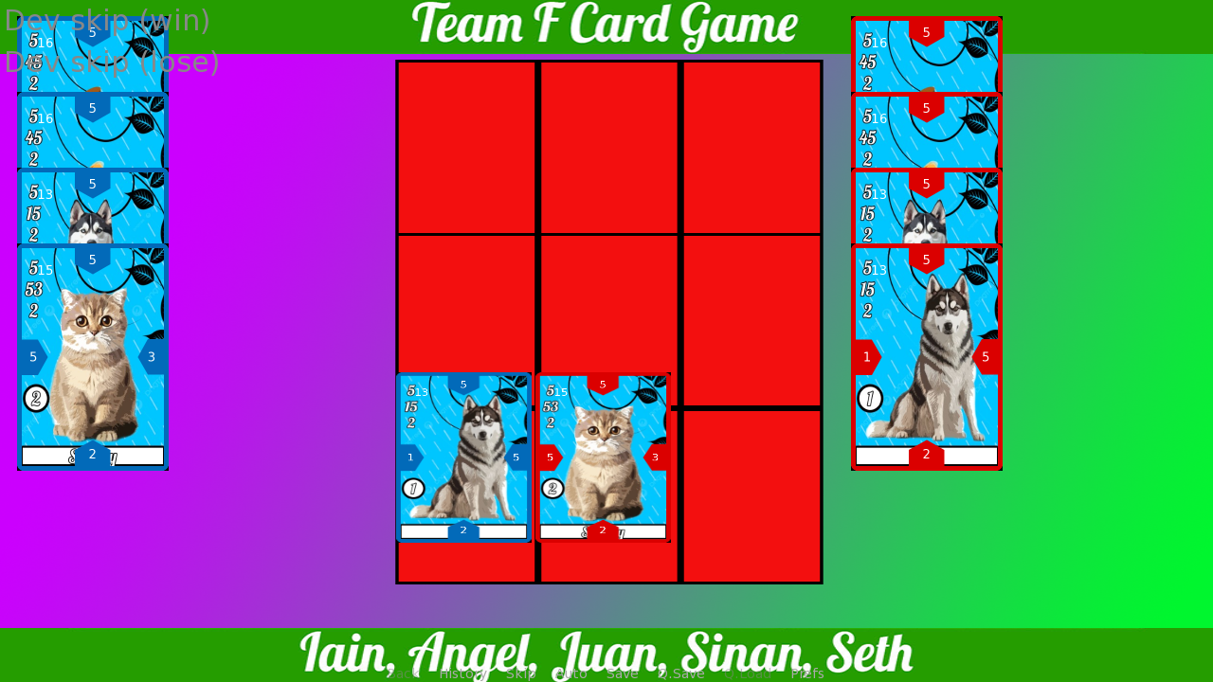
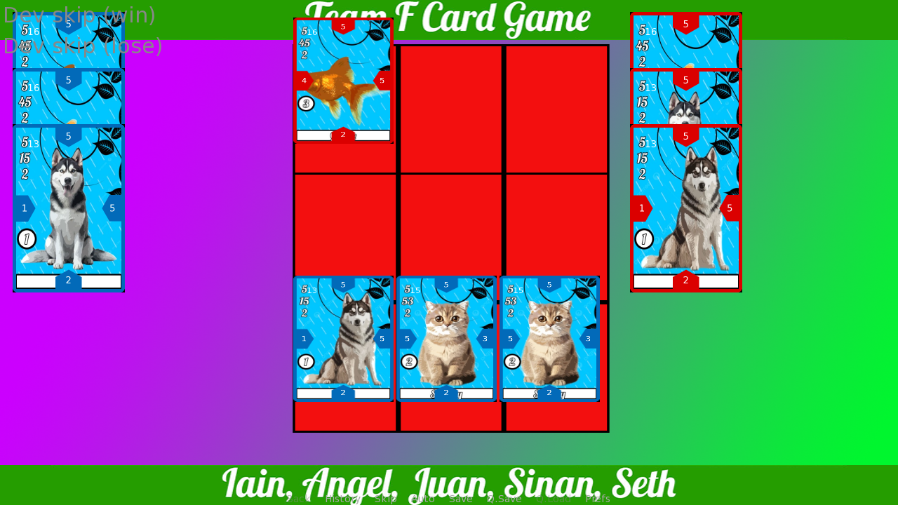
A before and after with working gameplay!

Slide 14
Conclusion
In conclusion this project has been a difficult set of challenges due to the challenges of online learning and the nature of Groupwork. However, I believe our small group has overcome serious challenges even if the current project is barebones. For having so many fundamental challenges and a general lack of participation by Seth and Sinan we have managed to create a working project, with it being compatible with a multiplayer environment! Regardless of the loss of scope and planned features we accomplished something amazing and created a working game!

